Slide 1
Computer Networks 2025-2026 Exercises: Introduction
Johan Bergs – Andrei Belogaev
johan.bergs@uantwerpen.be – andrei.belogaev@uantwerpen.be

Slide 2
Schedule
When? | What?
Friday 13/2 | Lab 0 – Introduction
Friday 20/2 | No lab session
Friday 27/2 | Lab 1 – Application Layer + deadline lab 0
Friday 6/3 | Lab 1 (cont.)
Friday 13/3 | Lab 2 – Transport Layer + deadline lab 1
Friday 20/3 | Lab 2 (cont.)
Friday 27/3 | Lab 3 - Network Layer I (IPv4 and IPv6) + deadline lab 2
Friday 3/4 | Lab 3 (cont.) + Lab 4 – Network Layer II (routing)
Friday 10/4 | Easter holiday
Friday 17/4 | Easter holiday
Friday 24/4 | Lab 4 (cont.) + deadline lab 3
Friday 1/5 | No lab session (university closed)
Friday 8/5 | Lab 5 – Link Layer + deadline lab 4
Friday 15/5 | No lab session (university closed)
Th 21/5 + Fr 22/5 | Lab 6 – Link layer II + deadline lab 5

Slide 3
Lab weights & Deadlines
Weights
Deadlines
Lab name | Weight
Lab 1 | 5.0%
Lab 2 | 20.0%
Lab 3 | 22.5%
Lab 4 | 22.5%
Lab 5 | 22.5%
Lab 6 | 7.5%
When? | What?
Thursday 26/2 23:59 | Lab 0
Thursday 12/3 23:59 | Lab 1
Thursday 26/3 23:59 | Lab 2
Thursday 23/4 23:59 | Lab 3
Thursday 7/5 23:59 | Lab 4
Wednesday 20/5 23:59 | Lab 5
Monday 25/5 23:59 | Lab 6

Slide 4
Queueing

Slide 5
Default queues: Tail dropping, FIFO
Packets are transmitted as soon as possible
Queues are FIFO queues
As new packets arrive, they are placed at the back of the queue
When a packet arrives and the queue is full, that packet gets dropped
So, with a queue that can hold 1000 packets, what happens?

Slide 6
Queues and bottleneck links / delays in mininet
When you introduce a bottleneck link, packets need to be queued by the router
Similarly, in mininet,when you introduce a delay or a bandwidth limitation on a link, another queue is added to buffer the packets (in order to delay them/enforce the bandwidth limitation).
The problem with that queue, is that:
By default, it can hold 1000 packets
By default, it is a FIFO queue
By default, it uses tail dropping
For delay queues, this is not a problem; they just hold packets for the delay period.
However, bandwidth limitations can cause a queue to fill up, which can result in very large extra delays in the network!

Slide 7
Mininet Demo

Slide 8
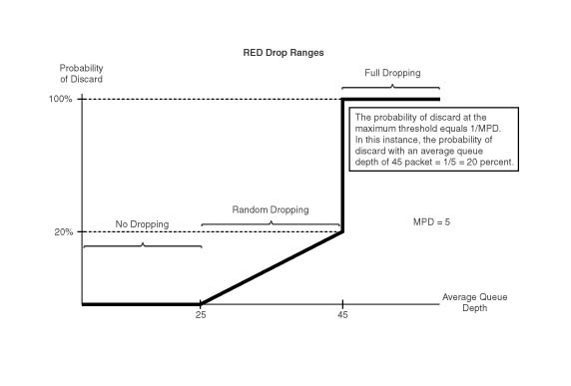
RED (Random Early Detection/Discard/Drop)

Slide 9
RED Operation
The goal is to have a small queue size, which is good for interactivity while not disturbing TCP/IP traffic with too many sudden drops after a burst of traffic.
The average queue size is used for determining the marking probability (not the real queue size)
newavg = (1 – w_{q}) . oldavg + w_{q} . current_queue_length
When the average queue size is below min bytes, no packet will ever be marked.
When it exceeds min, the probability of doing so climbs linearly up to probability (at max bytes average queue size)
Because probability is normally not set to 100%, the queue size might conceivably rise above max bytes.

Slide 10
Mininet Demo

